Slide 1
Start Your Plan Here:
Implementing a Big-League Relationship Management Program for Your Small Shop
April 17, 2023
AFP ICON, New Orleans
Timothy J. Dougherty
Chief Advancement Officer

Slide 3
Wealth Distribution in the U.S.
Source: US Federal Reserve

Slide 4
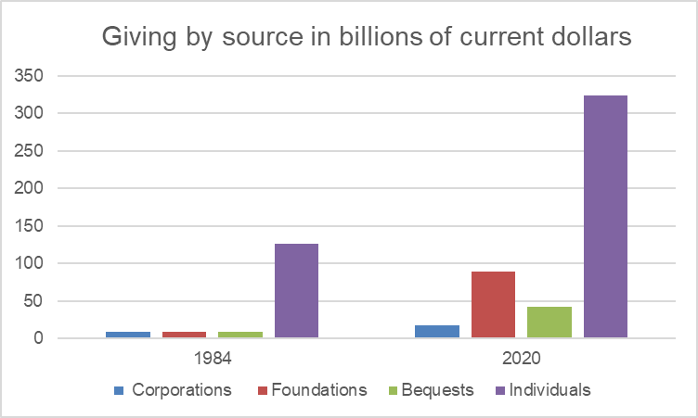
Source: Giving USA

Slide 5
BASIC FUND-RAISING PRINCIPLES

Slide 6
Donor “Pyramid” is now a Witch’s Hat
Dollars
# of Donors

Slide 7
Affinity, Propensity and Capacity
$
Affinity

Slide 9
The Secret of Success in Fundraising
Optimize Your Activities to focus on those with greatest Affinity, Capacity and Propensity
Bring donors in & up the pyramid
Engage in a genuine relationship to bring them into the inner circle
Ask them for money!!!!!

Slide 10
The Relationship Manager’s Job
Know more about them, and their interactions with your organization, than anyone else at the organization
PROACTIVELY facilitate the strengthening of their relationship to your organization, including the solicitation and stewarding of their contributions.

Slide 11
Three Important
Relationship Management
Guidelines
ONLY FRONTLINE FUNDRAISING STAFF CAN SERVE AS A RELATIONSHIP MANAGER (RM), THOUGH OTHERS CAN INTERACT OR BE OUT FRONT
ONE FULL-TIME RM CAN MANAGE ABOUT 120 DONOR HOUSEHOLDS, NOT MORE
EACH OF YOUR TOP PROSPECTS MUST HAVE AN RM

Slide 12
Who Are Your Top Prospects?
Remember, LINKAGE, INTEREST AND ABILITY
About 15% of our donors are “tracked.” We use A, B, C to distinguish
$1M prospect
$100,000 prospect
$50,000/$10k annual gift prospect
We focus most of our time, attention and energy on these individuals

Slide 13
Giving by Adv Track
Adv Track | # Donors | Amount | Percent of Total
A | 16 | $1,699,500 | 66%
B | 29 | $381,088 | 15%
C | 23 | $153,609 | 6%
None | 259 | $344,970 | 13%
TOTAL | 327 | $2,579,268 | 100%

Slide 14
What are you going to do with your top prospects?
BRING THEM INTO THE CIRCLE and MOVE THEM UP THE PYRAMID
Let’s Brainstorm – what are some good ways to ”bring people into the circle?”

Slide 15
Let’s Start Your Plan
My Advice:
Identify Your Top Prospects
Assign a relationship manager
Think through/ map out how to “bring them into the circle” and ”move them up the pyramid.”
LET’S START WITH TWO OR THREE OF YOUR DONORS RIGHT NOW!

Slide 16
Extra Slides follow
For reference only, i.e., not a planned part of presentation

Slide 17
The Major Gift Pipeline:
The Process
Reach out to prospective donors with linkage and ability - determine interest
If interested, engage, involve and invite regular (1x) support
Steward gifts, demonstrate impact, deepen relationship
Seek special (10x) gifts timed to institutional needs
Ultimate (1000x) gifts timed to factors in donor's life

Slide 18
The Major Gift Pipeline: The Numbers
One FTE MGO can qualify 300/ year
Estimate 20% will be interested
One FTE MGO can manage 120 donors
Portfolio in thirds: cultivation, solicitation, stewardship
One third of solicitations will be successful

Slide 19
Key Ingredients for Success in Major Gift Fundraising
Carefully nurtured relationships with "qualified" prospective major donors
Ability to show donors that their gifts have had an impact and been well used
Clear, compelling direction & aspirations, ideally with alignment across the organization
Infrastructure to support the fundraising process (staff, systems, processes)

Slide 20
Once at Altitude...
Ultimately, marginal ROI for an experienced major gift officer will be more than 10x
1x for operations will cover marginal expense
9x will be for restricted gifts: plant, new programming, or endowment
Non-frontline positions will diminish overall ROI, but are essential to enable success, e.g. operations director, stewardship coordinator, database administrator

